Slide 1
Welcome to the IPFS Capacity Deliverables
Webinar
June 25, 2015
The webinar will begin shortly

Slide 2
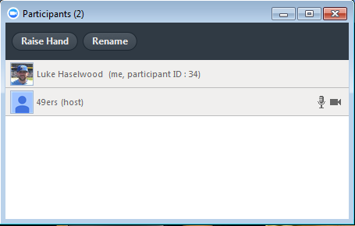
Zoom Overview
Mute/unmute your microphone
Turn on/off camera
View participant list
Raise hand chat - chat with individuals or all in meeting
Record (if host has given permission)

Slide 3
Capacity Workbook

Slide 4
Workbook Organization
Scanning Resources
Analyzing Resources
Taking Action

Slide 5
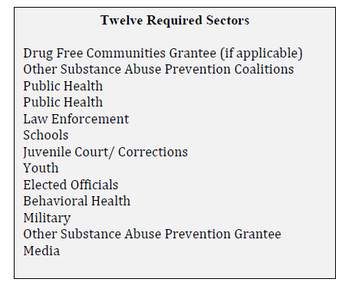
A Few Things To Keep In Mind
Use a diverse and broad group of stakeholders
Individual, small group and whole group input
Take the time now
Coalition, subgroup
or collaborative council
Required sectors
Ongoing process

Slide 6
Scanning Available Resources

Slide 7
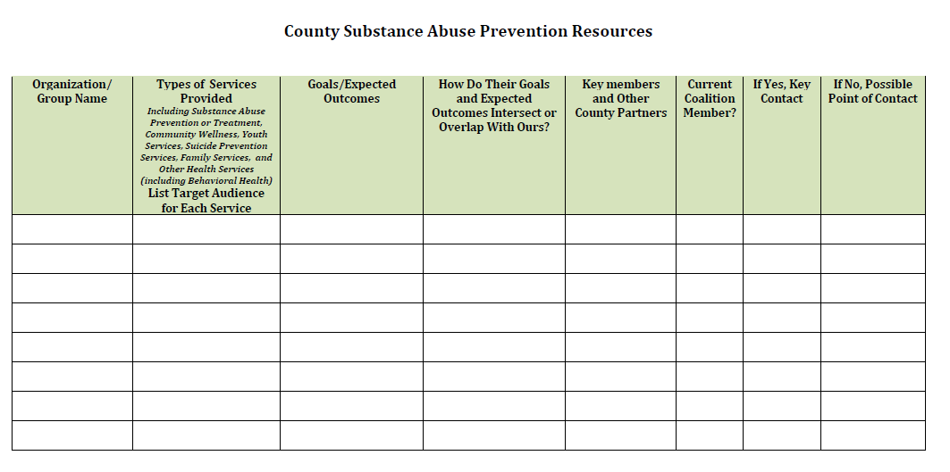

Slide 8
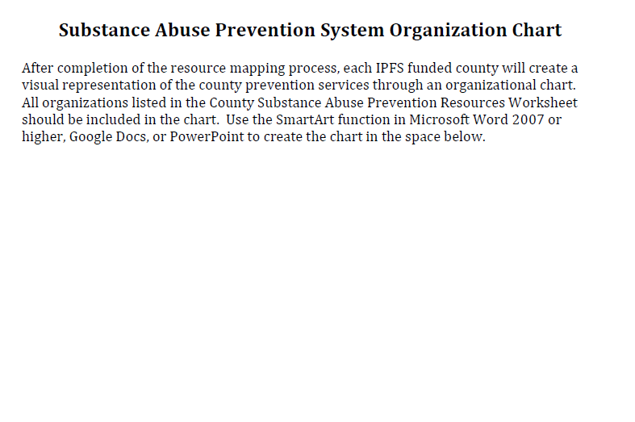

Slide 9
Analyzing Resources

Slide 10
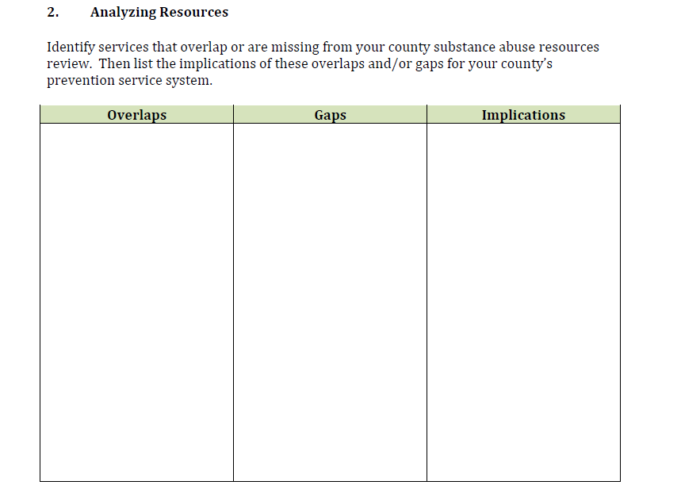

Slide 11
Taking Action

Slide 12
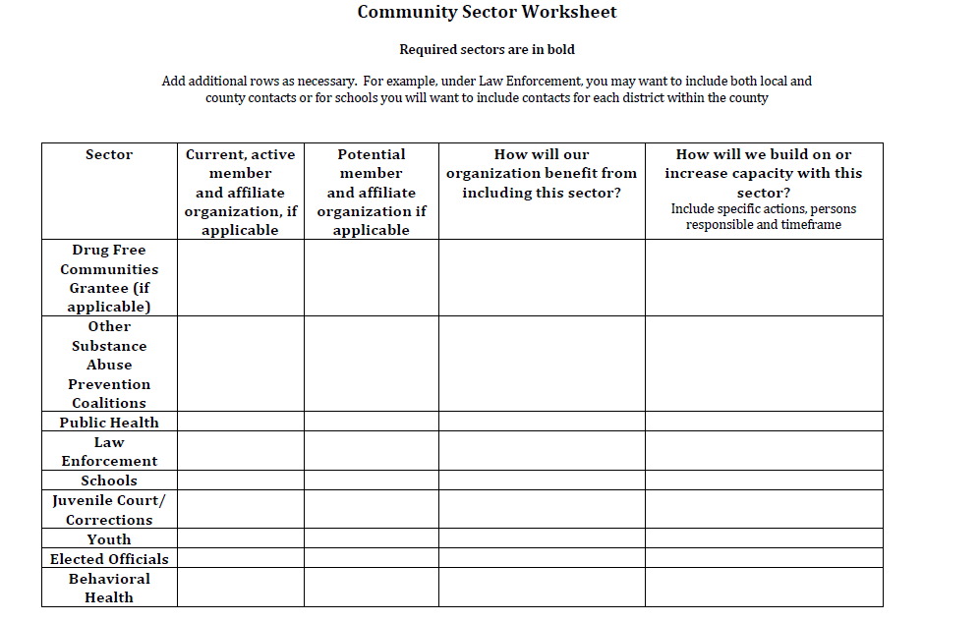

Slide 13
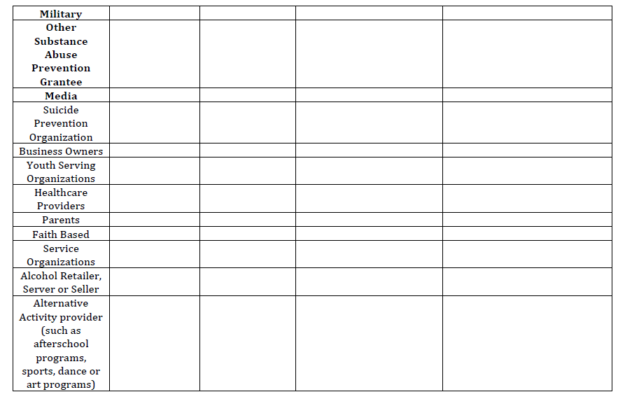

Slide 14
Capacity Checklist
Ongoing Process
Timeline: Update every six months
Scoring
NS Not Sure
1. Never: Our group does not do this
2. Sometimes: Our group sometimes does this
3. Most of the time: Our group does this most of the time
4. Always: Our group does this consistently/ always

Slide 15
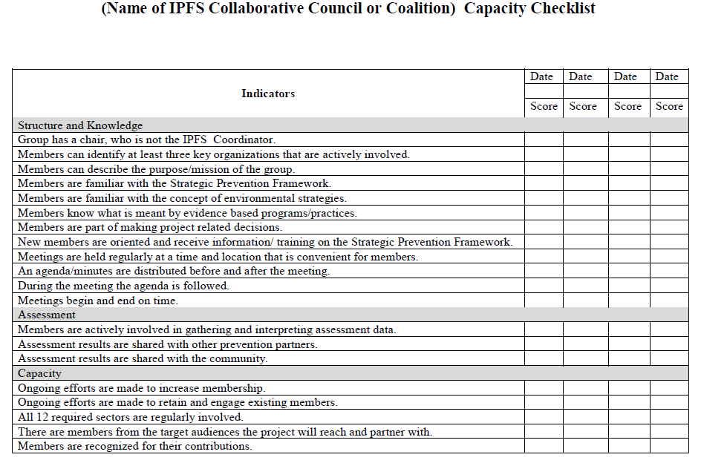

Slide 16
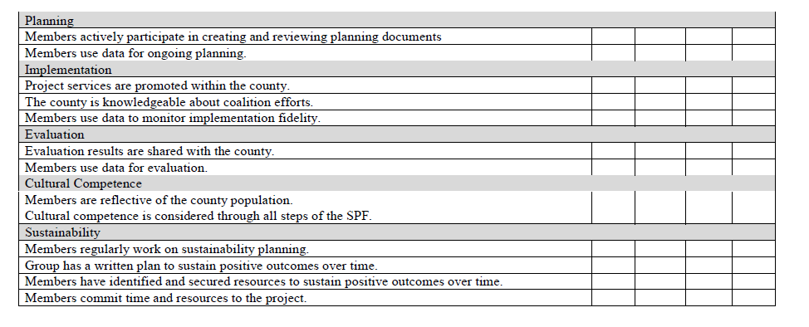

Slide 17
Consider your group’s responses to the Capacity Checklist and answer the following questions:
1. Where did your group give a score of NS, 1 or 2?
2. How can you move each of those items to a score
of a 3 or 4? What specific steps will you take? What will your timeline be?
3. Where did your group give a score of 3 or 4?
4. What is your group doing well that you will continue doing?
5. How will you use this information to increase your group’s effectiveness in using the SPF?

Slide 18
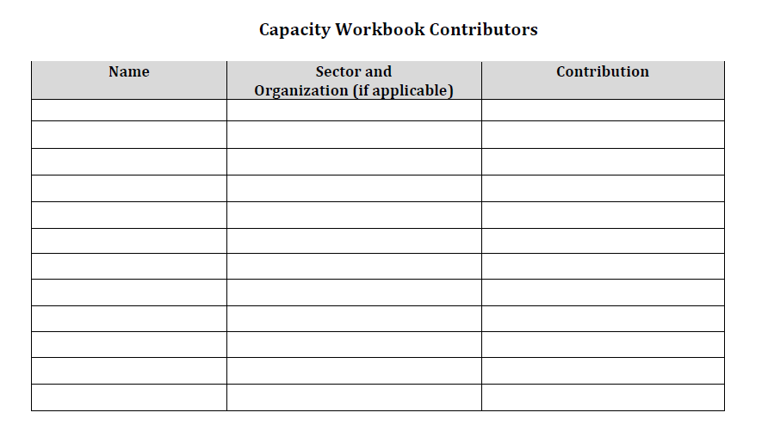

Slide 19
Submitting the workbook
Keep copies of all documents
Provide copies to the IPFS supervisor
Due September 8, 2015
Submit to Julie Hibben, IPFS Project Director via email at julie.hibben@idph.iowa.gov

Slide 20
Questions

